Slide 1
CS 441 - Requirements Engineering
Yongjie Zheng
Office: Science Hall 2 341
Email: yzheng@csusm.edu
Phone: (760) 750-8023

Slide 2
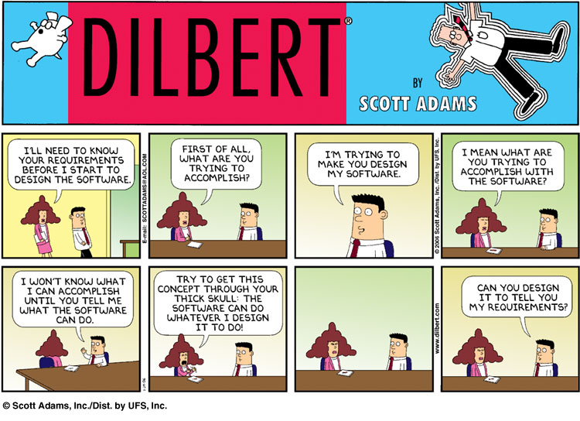

Slide 3
The hardest single part of building a software system is deciding precisely what to build. No other part of the conceptual work is so difficult as establishing the detailed technical requirements, including all the interfaces to people, to machines, and to other software systems. No other part of the work so cripples the resulting system if done wrong. No other part is more difficult to rectify later.
- Frederick P. Brooks Jr.

Slide 4
Outline
What is requirements engineering (RE)?
System-as-is, system-to-be, system requirements, software requirements, assumptions, domain properties, etc.
Requirements engineering process
Requirements elicitation
Requirements specification
Structured documentation
UML Use Case Diagrams

Slide 5
Existing Problems and Challenges with RE
The most common reasons for project failures are not technical.
The requirements for a system do not arise naturally; instead, they need to be engineered and have continuing review and revision.
The current state of RE practice is still fairly limited in terms of
Effort spent on this activity
Technology used to support it
Stakeholders may be numerous and distributed; their goals may vary and conflict; their goals may not be explicit or may be difficult to articulate.
A common misunderstanding: the requirement document may be felt to be too far away from the executable product for which the customer is paying. In fact, the quality of requirements does not indicate much about the quality of the executable product.

Slide 6

The Problem World and The Machine Solution
The world and the machine have their own phenomena while sharing others
RE is solely concerned with world phenomena, including shared ones [Jackson95]
unlike software design, concerned with machine phenomena
World
phenomena
Shared
phenomena
Machine
phenomena
MotorRaising
DriverWantsToStart
motor.Regime = ‘up’
stateDatabase
updated
errorCode = 013
HandbrakeReleased
World
Machine
handBrakeCtrl = ‘off’

Slide 7
System-as-is and System-to-be
System-as-is: the system as it exists before the machine is built into it.
System-to-be: the system as it should be when the machine will operate into it
Software-to-be: software to be developed - part of the machine, component of the system-to-be.
Environment: all other components of the system-to-be, including
People
Physical devices
Legacy software

Slide 8
Definition of Requirements Engineering (RE)
RE is a coordinated set of activities for exploring, evaluating, documenting, consolidating, revising, and adapting the objectives, capabilities, qualities, constraints, and assumptions that the system–to-be should meet based on problems raised by the system-as-is and opportunities provided by new technologies.

Slide 9
The Scope of RE: the WHY, WHAT, WHO Dimensions
System-as-is
System-to-be
WHY
a new system?
problems,
opportunities,
system knowledge
Objectives
satisfy
requirements,
constraints,
assumptions
WHAT
services?
assignment
WHO
will be responsible
for what ?

Slide 10
Why, What, and Who of RE
Why --- Identify, analyze, refine the system-to-be’s objectives.
What --- Identify & define the system-to-be’s functional services (software services, associated manual procedures).
to satisfy the identified objectives
according to quality constraints: security, performance, ...
based on realistic assumptions about the environment
Who --- assign responsibilities for the objectives, services, constraints among system-to-be components, including people, devices, pre-existing software, and software-to-be.

Slide 11
System Requirement and Software Requirement
A system requirement (aka user requirement) is a prescriptive statement to be enforced by the software-to-be, possibly in cooperation with other system components, and formulated in terms of environmental phenomena.
A software requirement (aka system requirement) is a prescriptive statement to be enforced solely by the software-to-be and formulated only in terms of phenomena shared between the software and the environment.
By default, requirement refers to system requirement.

Slide 12
Domain Property and Assumption
A domain property is a descriptive statement about the problem world.
An assumption is a statement to be satisfied by the environment and formulated in terms of environmental phenomena.

Slide 13
Functional and Non-functional Requirements
Functional requirements (aka features) describe what the system should do.
Non-functional requirements describe how the system should provide services. (e.g., constraints on the services or functions offered by the system).
Quality requirements: performance, security, reliability, extensibility, robustness, etc.
Compliance requirements: national laws, international regulations, social norms, etc.
Architectural requirements: distribution constraints, architectural styles, etc.
Development requirements: development cost, programming languages, tools, etc.

Slide 14
Non-functional Requirements

Slide 15
Examples of Non-functional Requirements
Safety requirements are quality requirements that rule out software effects that might result in accidents, degradations or losses in the environment.
Security requirements are quality requirements that prescribe the protection of system assets against undesirable environment behaviors.
Reliability requirements constrain the software to operate as expected over long periods of time. Its services must be provided in a correct and robust way in spite of exceptional circumstances.
Interface requirements are quality requirements that constrain the phenomena shared by the software-to-be and the environment.
Accuracy requirements are quality requirements that constrain the state of the information processed by the software to reflect the state of the corresponding physical information in the environment accurately.

Slide 16
Requirements Engineering Process
Requirements Elicitation and Analysis: collecting the requirements and understanding the problem.
Requirements Specification: describing the product to be delivered.
Requirements Validation and Verification: We have to ascertain that the correct requirements are stated (validation) and that these requirements are stated correctly (verification).
Requirements Negotiation: resolve conflicts that stakeholders may have.

Slide 17
Requirements Elicitation and Analysis
The primary goal of the requirements engineering phase is to elicit the contours and constituents of a fuzzy problem. This process is also known as conceptual modeling.
Involves requirements analyst, domain specialist, end users, and other stakeholders (e.g., management team).
The analyst often lacks a sufficiently profound knowledge of the application domain in which the problem originated. He/she has to learn the language of the application domain and become acquainted with its terminology, concepts and procedures. Especially in large projects, the application knowledge tends to be thinly spread amongst the specialists involved, which easily leads to integration and coordination difficulties.

Slide 18
Requirements Elicitation: Challenges
Turning an implicit conceptual model into an explicit model is difficult.
Implicit model: background knowledge, habits, and customs that are often not verbalized.
Explicit model: used to communicate with people.
The differences in background between the client, or user, and the software specialist.
Human memory consists of two components: a short-term memory in which information is being processed, and a long-term memory in which the permanent knowledge is stored.
A person being interviewed during requirements engineering may only use his/her short-term memory.
Humans are also inclined to be prejudiced about selecting and using information.

Slide 19
Requirements Elicitation: Techniques
Identifying stakeholders
Artifact-driven elicitation (domain understanding)
Background study
Data collection
Questionnaires
Prototypes and mock-ups
Stakeholder-driven elicitation
Interviews
Observation and ethnographic studies
Group sessions

Slide 20
Stakeholder Analysis
Stakeholders: groups or individuals affected by the system-to-be, who may influence its elaboration and its acceptance
Decision makers, managers, domain experts, users, clients, subcontractors, analysts, developers, ...
Selection criteria:
Relevant position in the organization
Effective role in making decisions about the system-to-be
Level of domain expertise
Exposure to perceived problems
Influence in system acceptance
Personal objectives and conflicts of interest

Slide 21
Elicitation Techniques
Questionnaire: a useful complement to interviews.
Interviewing stakeholders (e.g., customers) by the requirements engineering team (i.e., requirements analyst).
Process: select stakeholders, schedule a meeting, write a report, submit the report to the interviewee for approval.
Structured interview and unstructured interview.
Can be difficult to elicit domain knowledge through interviews.
Should be used in conjunction with other requirements elicitation techniques.
Observe customer (i.e., ethnography).
Groups of people are studied in their natural settings.
User requirements can be studied by participating in their daily work for a period of time.
Often used together with interviews.

Slide 22
Requirements Classification and organization
A hierarchical structure: higher-level requirements are decomposed into lower level ones. The high-level requirements are often termed goals.
Each requirement is refined (decomposed) into a set of subrequirements that together satisfy the parent requirement.
A viewpoint structure: links requirements to specific stakeholders.
Different stakeholders may have different sets of requirements.
E.g., Management may have a set of requirements, and the end-users may have (another) set of requirements

Slide 23
Prioritizing Requirements
Must haves: these are the top priority requirements, the ones that definitely have to be realized in order to make the system acceptable to the customer.
Should haves: these requirements are not strictly mandatory, but they are highly desirable.
Could haves: if time allows, these requirements will be realized as well. In practice, they usually won’t.
Won’t haves: these requirements will not be realized in the present version. They are recorded though. They will be considered again for a next version of the system.

Slide 24
Requirements Specification
Includes both the user requirements for a system and detailed specification of the system requirements.
Has a diverse set of users, who use the specification for different purposes.
The level of detail depends on the type of system being developed.

Slide 25
Requirements Specification: Criteria
Correct: The specification can be validated against other documents and by the end-user.
Unambiguous: We must be able to uniquely interpret requirements.
Complete: All significant matters relating to functionality, performance, constraints, and the like, should be documented.
Consistent: Different parts of it should not be in conflict with each other.

Slide 26
Requirements Specification: Criteria
Ranked for importance or stability
Verifiable: There must be a finite process to determine whether or not the requirements have been met.
Modifiable: The specification must be easy to change.
Traceable: The origin and rationale of each and every requirement must be traceable. A clear and consistent numbering scheme makes it possible that other documents can uniquely refer to parts of the requirements specification.

Slide 27
Requirements Specification: Outline

Slide 28
Requirements Specification Techniques
Natural language specification.
Structured specification (e.g., use cases)
Graphical notations: UML use case diagrams, UML state diagrams, data flow diagrams, ER diagrams.
Formal specifications: use a mathematical language (e.g., Z, CSP) to precisely define the functions of the system.

Slide 29
More on User Requirements
Invent a standard format and ensure all requirements adhere to that format.
Use language consistently.
Use text highlighting to pick out key parts of the requirement.
Avoid the use of computer jargon (e.g., special words).

Slide 30
Requirements Verification and Validation
We have to ascertain that the correct requirements are stated (validation) and that these requirements are stated correctly (verification).
Correctness, completeness, verifiability, consistency, etc.
V&V techniques.
Requirements reviews
Test-case generation
Formal analysis

Slide 31
Requirements Negotiation
Inevitably, different stakeholders have different views on the importance and priority of requirements and, sometimes, these views are conflicting. During the process, you should organize regular stakeholder negotiations so that compromises can be reached. It is impossible to completely satisfy every stakeholder but if some stakeholders feel that their views have not been properly considered then they may deliberately attempt to undermine the RE process.

